Slide 1

Breast cancer detection using machine learning classification algorithms Pavel Makarov

Slide 2
AGENDA
Introduction and Problem Statement
Data Description
Methods
Analysis
Conclusion

Slide 3
Introduction and problem statement
Techniques for connecting
Breast cancer accounts for approximately 30% of all new female cancer cases annually, making it the most common type of cancer in women.
Modern techniques, including laboratory tests, physical assessments, and breast scans, are critical for early detection and determining if a tumor is benign or malignant.
The project aims to develop a supervised machine learning model to automate the classification of tumors, reducing manual labor and minimizing human errors in breast cancer detection.

Slide 4
Data selection Laboratory cellular nuclei tests from Wisconsin Breast cancer data set

Slide 5
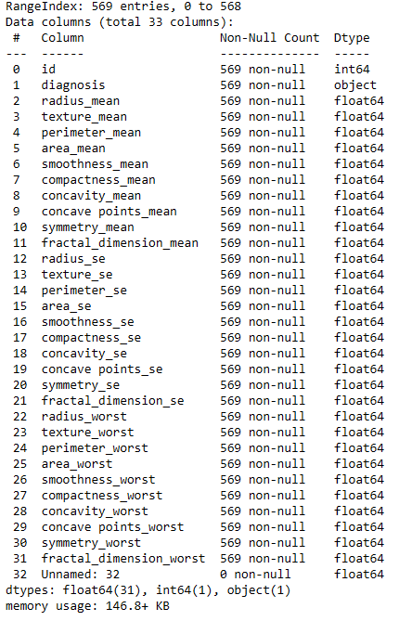
Wisconsin Breast cancer data from Kaggle.com
The data set consists of 569 entries and 33 columns
Most of the columns have numerical values
None of the features have missing values
The target feature “diagnosis” has to be re-coded from 2 =benign, 4=malignant to 0 = benign and 1=malignant for ML modeling

Slide 6
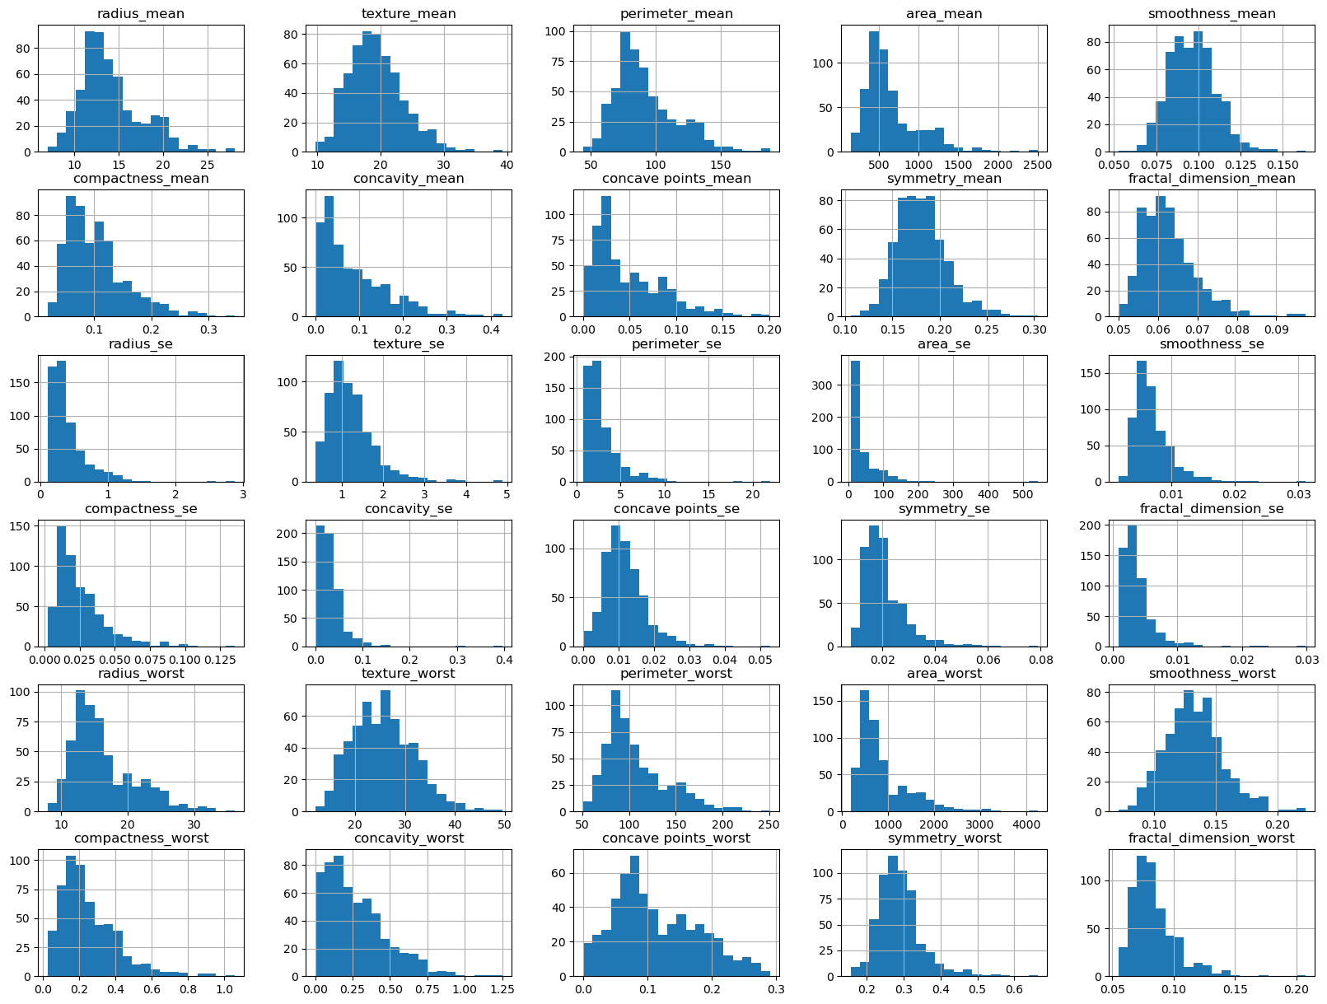
Feature values distribution
Most of the features have normal distribution and do not need any further transformation
Based on the plotted histograms the data set has no significant outliers

Slide 7
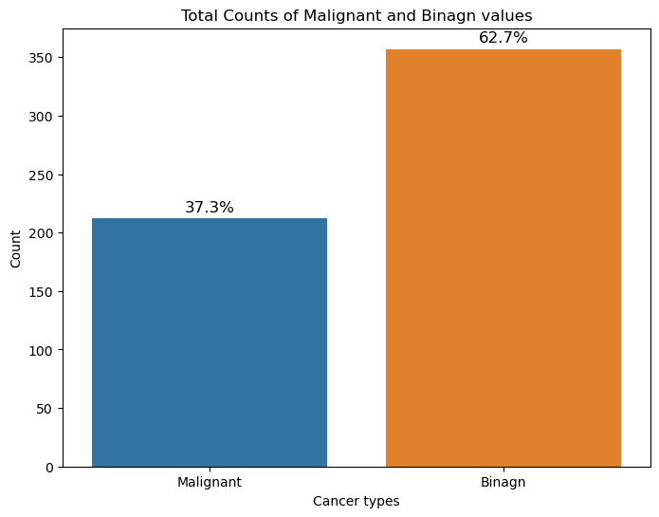
Class balance for target feature
The bar graph demonstrates the balance between target classes.
The ratio between classes is approximately 40% to 60%,
The target cannot be considered significantly imbalanced.

Slide 8
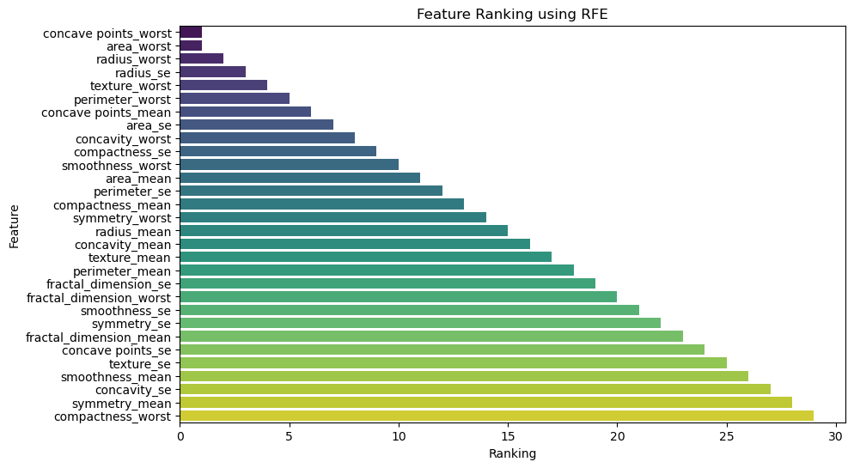
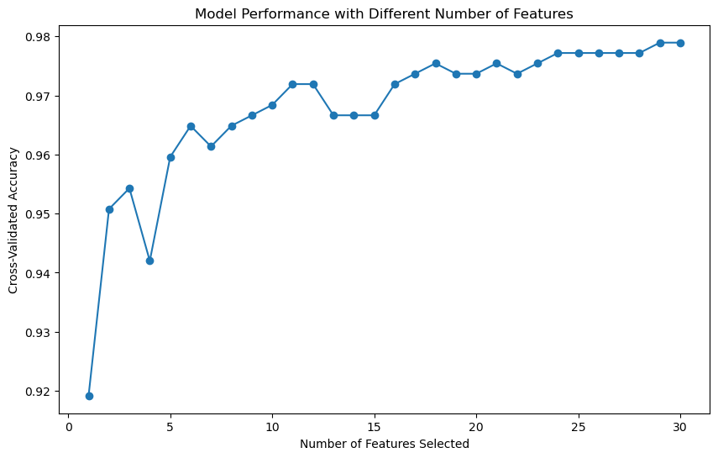
Recursive feature elimination. Feature rankings
This technique helps with feature selection. Based on the results, it was decided to keep all features.

Slide 9
Modeling Split data training/test 75/25 Logistic regression Random Forest XGBoost

Slide 10
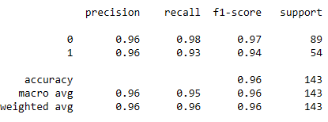
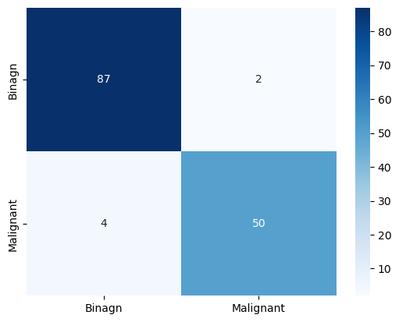
Logistic regression
Logistic regression is a supervised machine learning algorithm that accomplishes binary classification tasks by predicting the probability of an outcome, event, or observation.
Metrics
Pros:
Easy to Implement
Interpretability
Fast Training
Cons:
Assumption of Linearity
Sensitive to Outliers
Overfitting

Slide 11
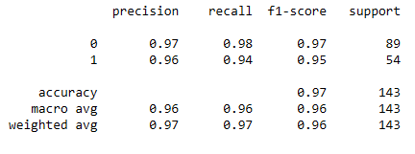
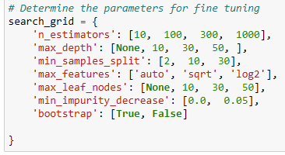

Random forest
Random forest is a commonly-used machine learning algorithm, trademarked by Leo Breiman and Adele Cutler, that combines the output of multiple decision trees to reach a single result.
Pros:
Accuracy/Reduced overfitting
Versatility
Robustness to noisy data
Tuning parameters
Metrics
Cons:
Computationally intensive
Sensitive to Outliers
Hard to interpret

Slide 12
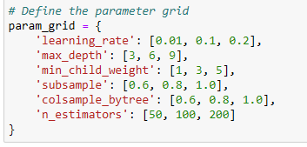
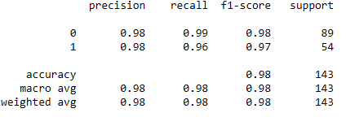
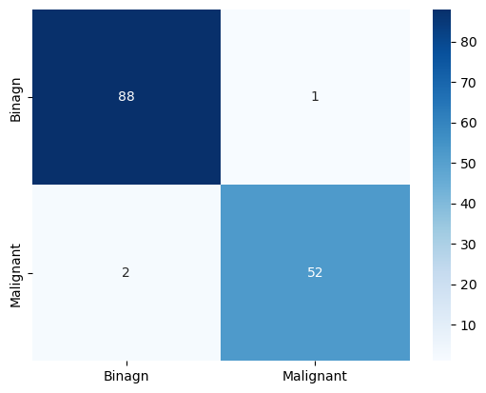
XGBoost
XGBoost is a scalable, distributed gradient-boosted decision tree (GBDT) machine learning library. It provides parallel tree boosting and is the leading machine learning library for regression, classification, and ranking problems.
Pros:
Accuracy/Reduced overfitting
Efficiency (speed and scalability)
Flexibility
Tuning parameters
Metrics
Cons:
Computationally intensive
Sensitive to noisy data
Complexity/Interpretability

Slide 13
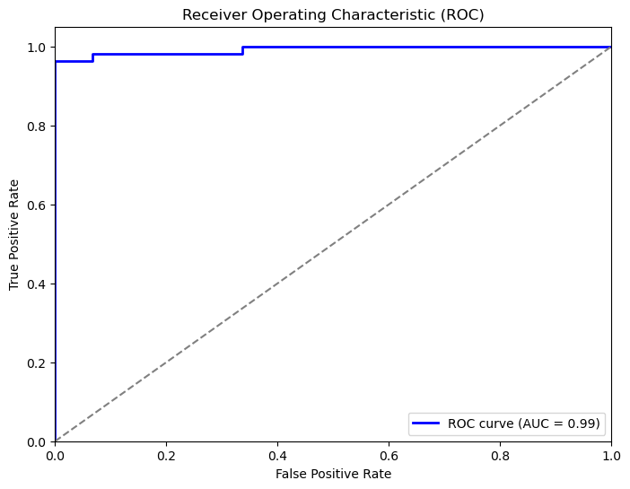
Receiver operating characteristic curve

Slide 14
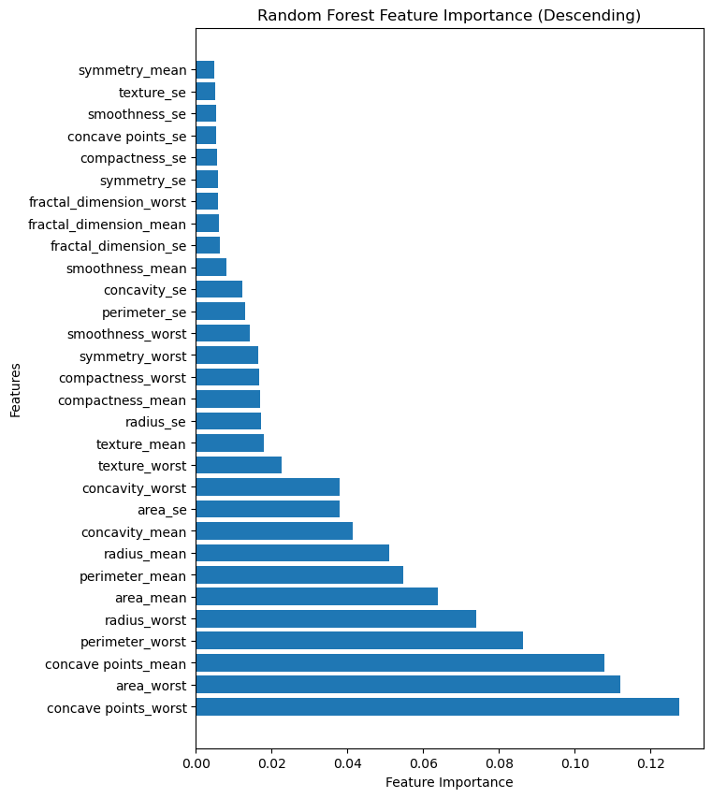
Conclusion
 | Precision |  | Recall |  | F1 score |  | Support
 | 0 | 1 | 0 | 1 | 0 | 1 | 0 | 1
Logistic Regression | 0.96 | 0.96 | 0.98 | 0.93 | 0.97 | 0.94 | 89 | 54
Random Forest Classifier | 0.97 | 0.96 | 0.98 | 0.94 | 0.97 | 0.95 | 89 | 54
XG Boost | 0.98 | 0.98 | 0.99 | 0.96 | 0.98 | 0.97 | 89 | 54
Feature importance
It is recommended to use the model's predictions in conjunction with careful assessment and treatment, rather than relying solely on the model's outcomes.
The model can be improved by training on a larger dataset to enhance its robustness and ensure better performance with new unseen data.
Ethical considerations include maintaining patient confidentiality, using high-quality and accurate data, obtaining informed consent, educating patients on data use, and ensuring legal compliance in handling patient data.

Slide 15
THANK YOU
Pavel Makarov
mack7151@gmail.com
https://www.linkedin.com/in/pavelmakarov90

